Slide 1
Lariat Rent-A-Car
Data Recommendation
5.18.19
Md Sharif Mia

Slide 2
Situation
2018 Lariat Rent-A-Car Snapshot
Total # of Cars in Fleet: 4000
Total Car Cost: $33,076,689
Total Net Revenue: $64,866,040
TOTAL PROFIT: $31,789,351
Lariat Rent-A-Car is trying to make better decisions about the vehicles it purchases for its fleet
Business objectives: minimizing costs + maximizing revenue
This deck includes recommended strategies to consider for optimizing these business objectives

Slide 3
Data Gathered + Assumptions
Data Gathered
Data provided by Lariat Rent-A-Car
Data set from 2018 only
Assumptions Made
The renter chose the car they rented
Car insurance rate from data set is the monthly rate
Calculated average monthly revenue based on car revenue data set

Slide 4
DATA MODEL
Details on data model delivered

Slide 5
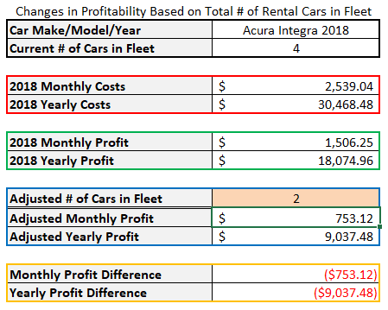
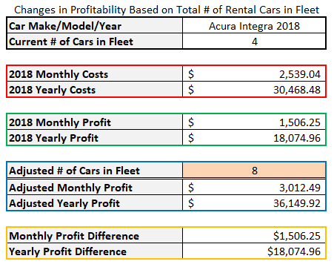
Model Examples
Decrease Adjusted Total
Increase Adjusted Total
Model is designed to be a user-friendly tool to identify changes in profitability based on the total number of rental cars in the fleet
This was created with a strategy of adjusting the fleet size, especially in underperforming cities

Slide 6
RECOMMENDATIONS
Recommendations based on data
gathered, processed and analyzed

Slide 7
Strategy Overview
The purpose of this model is to measure increase in profitability based on the total number of rental cars in the fleet and which cars are in the fleet.
Strategy #1
Eliminate the 50 cars with the lowest profit from the fleet
Strategy #2
Replace the 50 lowest profit cars with the 50 highest profit cars
Strategy #3
Increase the total number of cars in the fleet to increase the total profit

Slide 8
ELIMINATE CARS Eliminate the 50 cars with the lowest profit from the fleet*
Strategy #1
Graph shows 25 lowest profit-driving cars
This strategy will increase the yearly profit by $422,468
*Only 25 cars shown here for reference.

Slide 9
REPLACE LOW PROFIT CARS Replace the 50 lowest profit cars with the 50 highest profit cars*
Strategy #2
Graph shows top 25 profit-driving cars
This strategy will increase the yearly profit by $704,877
*This analysis does not take replacement costs into consideration. That can be explored with future cost analysis.

Slide 10
INCREASE CAR FLEET SIZE Increase total fleet size by 500 cars
City | Number of Cars | Monthly Rental Profit
Washington | 251 | $172,000.62
Charlotte | 182 | $129,398.33
Sacramento | 166 | $106,687.75
New York City | 165 | $108,755.14
Fort Worth | 164 | $104,382.93
Denver | 159 | $109,339.27
Los Angeles | 159 | $105,785.06
El Paso | 149 | $93,931.25
City | Number of Cars | Monthly Rental Profit
Kalamazoo | 61 | $39,277.79
Boise | 63 | $40,699.43
Tampa | 65 | $39,038.09
Tucson | 67 | $46,489.18
Lake Charles | 71 | $43,939.82
York | 72 | $48,545.65
San Antonio | 73 | $50,717.16
Houston | 73 | $44,707.24
Strategy #3
There is a direct correlation between number of cars in each city vs. the monthly profit generated in that city
We recommend that more cars are added to the fleets within the cities that Lariat would like to see generate more profit
Adding 500 cars to the fleet will increase the yearly profit by $3,973,669
Of the 50 lowest profit-driving cars, there are 8 with a total monthly cost under $700 to consider keeping in the fleet as a system test
GMC Savana 2016
Dodge Sprinter 2018
Nissan 240SX 2016
Ford Aspire 2017
Eagle Talon 2017
GMC Sierra 1500 2017
Fiat 500 2018
Lincoln Mark LT 2018

Slide 11
REPLACE CARS + INCREASE FLEET SIZE Replace 50 lowest profit cars with 50 highest profit cars AND increase fleet size by 500 cars
Combined Strategy
This strategy will increase the yearly profit by $4,808,238

Slide 12
NEXT STEPS
Suggested next steps to consider
with access to more data and results

Slide 13
Next Steps to Consider
Analyze taxes in each city and cost to replace low performing cars
Results may alter and/or focus best recommendations
How much money do accidents cost? Are there steps that can be taken to prevent accidents in these cities?
Access data from previous years to see if more patterns emerge
Gather more data on the size of each city to identify cities that may have potential for more rentals
Consider market testing in cities with the highest profit (test different cars, promotions, etc.)
Stronger marketing tactics in cities with lower profit and/or big population
Identify cities with more business travelers vs. less
Notes:
How much money do accidents cost?
York = lowest monthly profit + most accidents
Access data from previous years
Are there any patterns of cars that have a high overhead cost and/or aren’t rented often – potentially eliminate these cars?
Gather more data on size of city/potential renters
Focus more attention on low performing cities that may have potential for more rentals
Why is Houston’s monthly profit so small when it’s such a big city?

Slide 14
APPENDIX: DATA INSIGHTS
Additional insights gathered from data set that
was not included in the recommendation

Slide 15
Non-airport locations generated more monthly profit than airport locations
Might consider directing more resources to airport locations to increase profit margins
Monthly rental profit when looking at year of car model was too negligible to include in final recommendation
Worth noting that newer cars generate more profit

Slide 16
There is a direct correlation between a higher number of accidents in a city and higher car insurance costs
Consider car insurance deals or bundles in cities with high accident counts
Other Data Analyzed
Age of Renter
Gender of Renter
Location of Cars
Cities with Accidents
Type of Cars That Were in Accidents
Notes:
Age of Renter – didn’t matter much
Average age was 45 yrs old
Renters in most accidents varied from ages 25-61
Renters that rented cars for the most days varied from ages 30-61
Gender of Renter – didn’t matter much
# of times a car was rented was similar – both M and F about 50k times
# of accidents was similar – both M and F about 2500 times
# of days rented was similar – both M and F about 200,000 times
No trends within the rest of the data for location of cars, cities with accidents or type of cars that were in accidents

Slide 17
THANK YOU!

